Slide 1
Introduction to the Workshop:
The learner is expected to be able to synthesize most creative and innovative proposals and ideas outlining forward-looking collaborative work
Inspire Students Entrepreneurial Thinking to Drive Discovery, Creativity and Innovation
The European Commission's support for the production of this publication does not constitute an endorsement of the contents, which reflect the views only of the authors, and the Commission cannot be held responsible for any use which may be made of the information contained therein.
Notes:
https://quizizz.com/admin/quiz/5aa1713cafef7c001b8245ae/business-model-canvas

Slide 2
The workshop focuses on how to build the business organization for the creation of value. The main point is to relate the result desired by groups and individuals, highlighting the way in which added value is created.
The Personal business model canvas is an adaptation of Osterwalder's theory
The company's resources must be involved in the production processes. The operation is similar to the PBMC and can be used by the individual (description of who you are and what you have), by the team or by the manager who in this case uses the tool to carry out a competence needs analysis. In this case the starting room is the key activity (room number two) which describes what needs to be done to produce the utility in the production cycle. In practice, the first step outside the canvas is therefore to analyze the production processes to identify what must be done (job to be done).
PBMC for creative and innovative approach
Notes:
https://www.sbdc.duq.edu/Blog-Item-What-is-Business-Model-Canvas#:~:text=The%20Business%20Model%20Canvas%20consists,Key%20Partners%2C%20and%20Cost%20Structure.
https://www.thepowermba.com/en/blog/business-model-canvas
https://www.open.edu/openlearncreate/mod/oucontent/view.php?id=80404&section=6

Slide 3
The learner should be able to:
● Enhance and encourage uptake of innovation at ecosystemic level
● Organise processes and activities that maximise uptake of innovation at ecosystemic level
● Exploit innovative proposals making strategies for value creation
● Lead and implement innovation decisions into the company and within the network ecosystem
● Minimize risk when implementing innovative business decisions.
Learning Outcomes to be covered
Notes:
https://www.sbdc.duq.edu/Blog-Item-What-is-Business-Model-Canvas#:~:text=The%20Business%20Model%20Canvas%20consists,Key%20Partners%2C%20and%20Cost%20Structure.
https://www.thepowermba.com/en/blog/business-model-canvas
https://www.open.edu/openlearncreate/mod/oucontent/view.php?id=80404&section=6

Slide 4
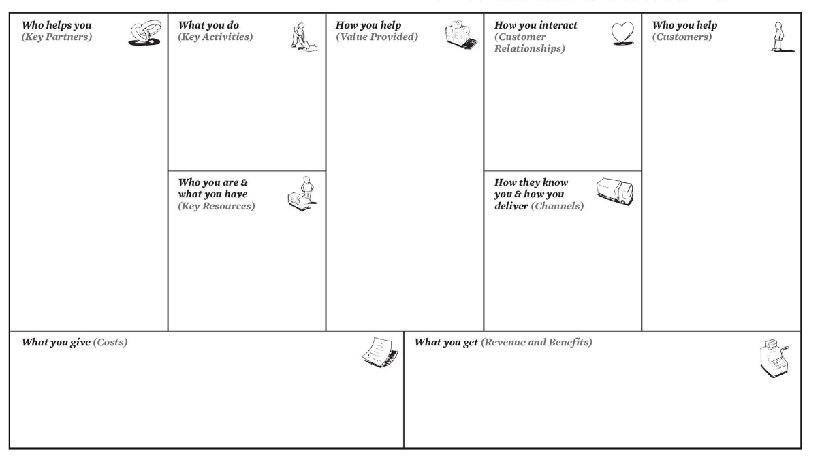
Workshop Title

Slide 5
Workshop Title
WHO YOU ARE / WHAT YOU ARE (KEY RESOURCES) The Personal Key Resources block includes who you are: (1) your interests, (2) skills and abilities, and (3) personality and what you have: knowledge, experience, personal and professional contacts, and other tangible and intangible assets or resources.
WHAT YOU DO (KEY ACTIVITY) To fill this building block, think about the critical tasks you regularly perform at work. Note only the key activities carried out for customers / partners / stakeholders and do not yet describe the resulting value. You may come up with a long list of tasks, but try to narrow that list down to keep the really important tasks on the canvas. Remember that key activities (what you do) evolve over time and also depend on who you are

Slide 6
Workshop Title
WHO YOU HELP (TARGET CUSTOMER) So, think about who you help. These are your "Customers" or "Customer Groups". These include the people within your organization who depend on your help to get the job done. This may include your boss or supervisor, but in reality, anyone who depends on the benefits of your job as well. You can also include customers or businesses purchasing your organization's services or products, your organization's key partners, or even the larger communities your work serves.
AS AID (VALUE PROPOSALS) In this section of the canvas, describe how you help people get their work done and what value it brings. When you reflect on your career, this is the most important section of the canvas. What job are you hired for and what benefits do customers get? To help you with this reflection, you can also think about your key activities and how they translate into value for your customers.

Slide 7
Workshop Title
HOW DO THEY KNOW YOU/HOW DELIVERIES (CHANNELS)
This block includes five key questions related to the main marketing phases: awareness, evaluation, purchase, delivery and after sales. The questions to be answered are:
How do potential customers find out about you?
How does your help customers evaluate your value?
How do new customers hire you or purchase your services?
How do you deliver value to customers?
How do you continue to support customers and make sure they are satisfied?
To help you with this reflection, you can also think about your key activities and how they translate into value for your customers.
HOW YOU INTERACT (CUSTOMER RELATIONS)
In this building block, can you describe how you interact with customers? (face-to-face, remotely, by email or otherwise) Are your relationships characterized by single transactions or ongoing services? Do you focus on growing your customer base (acquisition) or on satisfying existing customers (retention)?l

Slide 8
Workshop Title
WHO HELPS YOU (KEY PARTNER)
List Key Partners here who support you as a professional or help you do your job successfully. They can provide you with motivation, advice, opportunities, or even resources.
They could be colleagues or mentors at work, members of your professional network, family or friends, or professional counselors.
COST STRUCTURE WHAT YOU GIVE
Costs are what you give and commit to your work: time, energy and money, mainly. List the soft and hard costs associated with your job.
The soft cost can include: stress or dissatisfaction, lack of opportunities for personal or professional growth, little recognition or social contribution.
Examples of high costs are: excessive travel time or commitments, unpaid commuting, travel expenses, training, education, tools, materials, or other costs.

Slide 9
WHAT YOU GET (REVENUE STREAM)
That block is dedicated to sources of income (salary, contractor or professional fees, stock options, royalties, and any other cash payments). However, other benefits can be added ((health insurance, pension packages, school assistance, ...).As you go further in perfecting your personal business model, you can include soft factors, such as professional development, flexible hours, satisfaction, recognition, and social contribution.

Slide 10
Workshop Title
Activities of this Workshop
The PBMC is a very powerful but also a complex tool. You can have multiple level (team, personnel and entire company). This could lead to confusion in reading the canvas until you have sufficient mastery. Make it clear by linking together with lines of different colors or by writing directly in different colors the value propositions and connections with the various rooms of the PBMC. It is a visual technique and it is very important to work with order and clarity

Slide 11
Workshop Title
Activities of this Workshop
ACTIVITY 1
Step 1: Who are you and what do you have (key assets)
Room 1
List the main personal elements you bring into play in your profession. That that needs to be present in the organizationDescribe what excites you the most about your job:
interact with people;
2) deal with information / ideas
3) dealing with things and objects, working outdoors. Also describe talents (things you naturally do without effort) and skills (things you have learned to do).Finally, list some of the other resources you need: values, personal network, reputation, personal brand, industry experience, manual skills, material assets, tools, etc.

Slide 12
Workshop Title
Activities of this Workshop
ACTIVITY 2
Step 2: Who we are and what do we have (key assets)KEY ACTIVITIES(What are you doing)
Room 2
List the most important activities that need to be performed constantly at work and that characterize the professions compared to others. Which of these activities is necessary for the Value Proposition? What activities to carry out to implement the Channels and / or promote Relations with Customers?
CONSIDER THE ACTIVITIES THAT FALL IN THE FOLLOWING AREAS:- Making (building, designing, creating, solving, o ering, etc.)- Selling (inform, persuade, teach, etc.)- Support (administer, calculate, organize, etc.)

Slide 13
Workshop Title
Activities of this Workshop
Step 3: who help you?
Room 3 CUSTOMERS
(Who are you useful to)Who do you create value for?Who are your most important customers?Who depends on you to do their job?TYPES:- People- Companies- Employers, managers, colleagues, users, etc.
Room 4 PROPOSAL OF VALUE
(How do you make yourself useful)What value do you provide to customers?What problem do you solve or need satisfied?In what important task do you help your customers?Describe the specific bene ﬁ ts that Clients get as a result of your work. CONSIDER IF WHAT YOU PROPOSE:- Reduces the risk- Decreases costs- Increase convenience or usability- Improve performance- Increase pleasure or satisfy basic needs- Satisfy a social need (brand, status, recognition, etc.)- Satisfy an emotional need Etc.

Slide 14
Workshop Title
Activities of this Workshop
ACTIVITY 4
Step 4: identify the internal and external resources indispensable for the production of value
Room 5 CHANNELS(How do you make yourself known and how do you bring value)
How do you make yourself known to your potential customers? How do they know you are useful to them? How do you get them to buy what you do for them?How do you transfer your Value Proposition to Customers? With what tools do you support your customers and make sure they are satisfied?
Room 6 RELATIONS WITH CUSTOMERS(How do you interact)
What style of relationship do you establish and maintain with your customers? List the modalities you develop with the aim of:
convince potential customers to become one
2) persuade current customers to remain so
3) make them buy more or something else.
SOME EXAMPLES COULD INCLUDE:- Personal assistance, dedicated personal assistance- Automated services, self service (e.g. publication of online guides, etc.)- Remote assistance, support community- Leadership vs. co-creation- Continuous vs. occasional (e.g. on a project basis)- Live vs. indirect (through other people)- Proactive vs. reactive- Customer specific know-how, customization- Type of contract (fixed-term, restricted, etc.)- Recurring sales, at the customer's choice, discounts, offers, promotions, etc.

Slide 15
Workshop Title
Activities of this Workshop
ACTIVITY 5
Step 4: identify the internal and external resources indispensable for the production of value
Room 7KEY PARTNER(Who helps you)
Who helps you create and deliver value to customers?
Who supports you in other ways and how
Do you have partners who provide Key Resources or perform Key Activities for you?
KEY PARTNERS MAY INCLUDE:
Friends
Family members
Supervisors
Human resources personnel
Colleagues and collaborators-
Providers; Professional associations; Mentors, consultants, etc.

Slide 16
Workshop Title
Activities of this Workshop
ACTIVITY 5
Step n: 5 investigate how cost and revenue flows are created
Room 8 COSTS
(What do you give)What do you give to your work (time, energy, etc.)?
What do you give up for work (family or personal time, etc.)?Which Key Activities are the most "expensive" (draining, stressful, etc.)?Which Key Partners are the most demanding in terms of time, money or resources?
LIST THE COSTS ASSOCIATED WITH YOUR JOB:
Material costs:- Time, excessive travel commitments- Commuting, travel expenses not reimbursed- Self-financed training, education, equipment, materials, other costs- Suppliers, consultants, etc. Etc.Intangible costs:- Stress or dissatisfaction- Lack of opportunities for personal or professional growth- Low recognition or contribution to the community Etc.

Slide 17
Workshop Title
Activities of this Workshop
ACTIVITY 5
Step n: 5 investigate how cost and revenue flows are created
Room 9 REVENUES AND BENEFITS (What you get)What do you get from your job? What do your customers compensate you for? In what ways do they do this?
DESCRIBE REVENUES AND BENEFITS:
Those materials could include:- Wages, salaries, professional fees- Payments in kind, trade in goods or services- Health insurance, social security contributions- Stock option, profit sharing- Support to Etc. Intangible ones could include:- Satisfaction, pleasure- Professional development- Recognition- Contribution to society- Flexible schedules or conditions Etc.

Slide 18
Thank You!
Do you have any questions before we go?
The European Commission's support for the production of this publication does not constitute an endorsement of the contents, which reflect the views only of the authors, and the Commission cannot be held responsible for any use which may be made of the information contained therein.

