Slide 1
Introduction to the Workshop:
The learner is expected to be able to analyze, evaluate, consider the surrounding business environment
Inspire Students Entrepreneurial Thinking to Drive Discovery, Creativity and Innovation
The European Commission's support for the production of this publication does not constitute an endorsement of the contents, which reflect the views only of the authors, and the Commission cannot be held responsible for any use which may be made of the information contained therein.

Slide 2
The learner is expected to be able to analyze, evaluate, consider the surrounding business environment
The learner is expected to be to analyze, evaluate, consider the surrounding business environment.
The learner should be able to:
explain the business environment components
describe the key factors of the business environment
describe how organization can react to surrounding business environment
analyze the factors of the business environment
interpret the factors of the business environment
Learning Outcomes to be Covered

Slide 3
The learner is expected to be able to analyze, evaluate, consider the surrounding business environment
This Workshop includes 3 activities.
The first activity concerns macro and microenvironment in which a business operates, adapting to take advantage of emerging opportunities and to minimize potential threats. The second and third activities introduce the business analysis models that are useful tools and techniques that can help learners to understand and analyze business environment and think more strategically about business. Finally, there is a short online quiz that allows the self-assessment of the trainees.
Short Introduction

Slide 4
The learner is expected to understand the political, economic, social environment in relation to business
Activity 1: Macro- and microenvironment
Macroenvironment: The larger societal forces that affect the whole microenvironment –
demographic, economic, natural, technological, political and cultural forces.
Microenvironment: The forces close to the organization that affect its ability to serve
its customers – the organization, market channel firms, customer markets, competitors and publics, which combine to make up the organization’s value delivery system.

Slide 5
The learner is expected to understand the political, economic, social environment in relation to business
Macroenvironment
Political forces
Demographic forces
Organization’s Microenvironment
Economic forces
Technological forces
Natural forces
Cultural forces

Slide 6
The learner is expected to understand the political, economic, social environment in relation to business
Microenvironment
Suppliers
Marketing intermediaries
Customer market
Organization
Competitors
Publics

Slide 7
The learner is expected to understand the political, economic, social environment in relation to business
Microenvironment – actors’ types
Marketing intermediaries are firms that help the organization to promote, sell and distribute its goods to final customers. They include resellers, physical distribution firms, marketing services agencies and financial intermediaries.
There are six types of customer market – (1) consumer markets, (2) business markets, (3) reseller markets, (4) institutional markets, (5) government markets, and (6) international markets.
A public is any group that has an actual or potential interest in or impact on an organization’s ability to achieve its objectives and includes financial publics, media publics, government publics, citizen action publics, local public, general publics and internal publics.

Slide 8
The learner is expected to understand the political, economic, social environment in relation to business
Exercise 1
Select a company that produces and markets sports and leisure clothing.
What makes up an organization’s external macroenvironment?
Use a worksheet (Attachment C8_6_02) to write down your answers.
Answer the question:
What are the major environmental trends that are likely to create opportunities and ones that will present threats to this company?

Slide 9
The learner is expected to understand the political, economic, social environment in relation to business
Activity 2: Importance of environmental scanning and monitoring
Environmental scanning means gathering information from an organization's macro- and microenvironments and careful monitoring of these environments to identify future threats and opportunities.
The environment of a business is highly dynamic. It is always in flux, i.e. constantly changing. This means that the future of the business is also ever-changing. And the organization must keep a close at its environment via environmental scanning.

Slide 10
The learner is expected to understand the political, economic, social environment in relation to business
The process of monitoring and evaluating the nature and direction of change in the business environment.
Identification of strength
Identification of weakness
Identification of opportunities
Identification of threat
Optimum use of resources
Survival and growth
To plan long-term business strategy
Environmental scanning aids decision-making
Business Environmental monitoring

Slide 11
The learner is expected to understand the political, economic, social environment in relation to business
Activity 3: Porter’s Five Forces model and PESTEL analysis
Porter's Five Forces model are five separate threat factors that can impact business growth.
The Five Forces are follows:
The intensity of the competitive landscape;
Level of supplier power;
Buyer’s entry/exit costs;
The threat of substitute products;
Access to the market for new entrants.
The objective of Porter's Five Forces model is to assess the overall competitive landscape of a particular business sector. Each of these five forces corresponds to a key component of market intensity.

Slide 12
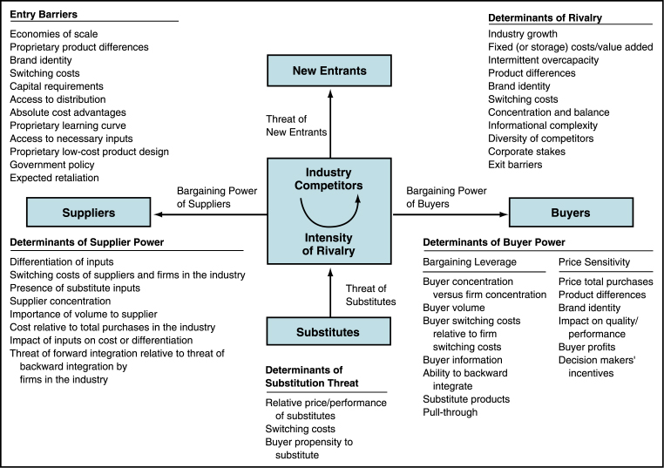
The learner is expected to understand the political, economic, social environment in relation to business
Porter’s Five force model

Slide 13
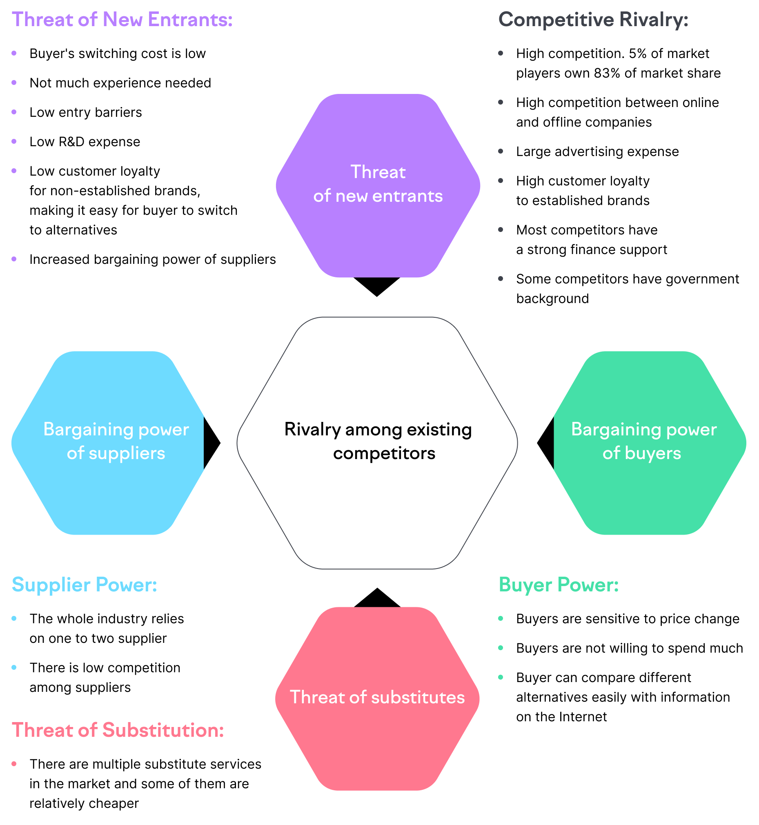
The learner is expected to understand the political, economic, social environment in relation to business
Porter’s Five Forces model: example
Source: Semrush Blog, https://www.semrush.com/blog/understanding-porters-five-forces-model/?kw=&cmp=EE_SRCH_DSA_Blog_EN&label=dsa_pagefeed&Network=g&Device=c&utm_content=622527972616&kwid=dsa-1754979153285&cmpid=18361923498&agpid=140825919105&BU=Core&extid=54795788369&adpos=&gclid=Cj0KCQjwyt-ZBhCNARIsAKH1176_K6rg3vxNyXdWfV_wyd8muQ0eU5b6D5yAEsAYYMfrAez1xWETqQoaAsCaEALw_wcB

Slide 14
The learner is expected to understand the political, economic, social environment in relation to business
Exercise 2
Select a company that produces and markets sports and leisure clothing. Use Porter’s model to help understand forces in your environment and to help understand the potential return (if any) on a new product or service.
Use a worksheet (Attachment C8_6_03) to write down your answers.

Slide 15
The learner is expected to understand the political, economic, social environment in relation to business
PESTEL analysis
PESTEL Analysis is a strategic framework used to evaluate the external environment of a business by breaking down the opportunities and risks into Political, Economic, Social, Technological, Environmental, and Legal factors.

Slide 16
The learner is expected to understand the political, economic, social environment in relation to business
PESTEL analysis
Political factors include government policies and laws, taxation policies, budgets, international trade laws, trade restrictions, and even environmental laws in place.
Economic factors are inclusive of both micro and macroeconomic factors. Macroeconomic factors like the market demand, interest rate, taxation policies, total expenditure, etc relate to the economy as a whole. Microeconomics focus on single households – disposable income, customer choices, and preferences, etc.

Slide 17
The learner is expected to understand the political, economic, social environment in relation to business
PESTEL analysis
Social factors like age, gender ratio, population growth, urban-rural divide, employment rates, health statistics, preferences, etc of a given population affect the sale of the product or service and hence the profit of a business.
Technological factors involve the presence and innovation of technology and the growth of technology in a market.
Legal factors include any changes in laws and legislation, health and safety guidelines, guidelines for equality and safety of women, consumer rights, etc.

Slide 18
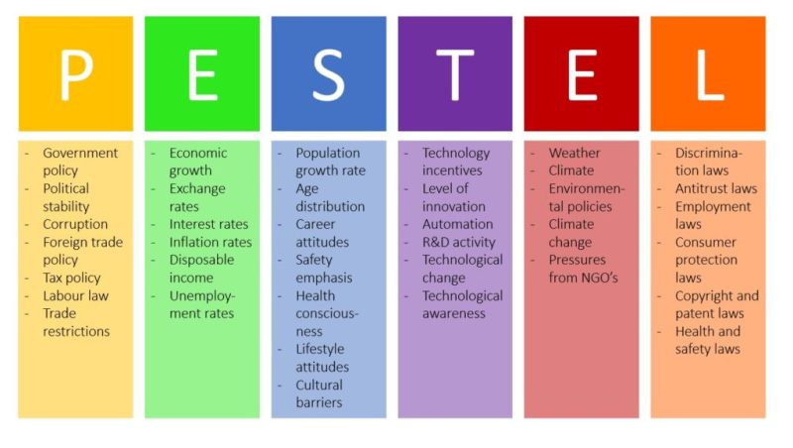
The learner is expected to understand the political, economic, social environment in relation to business
PESTEL analysis

Slide 19
The learner is expected to understand the political, economic, social environment in relation to business
Exercise 3
Select a company that produces and markets sports and leisure clothing. Use Porter’s model to help understand forces in company’s environment and to help understand the potential return (if any) on a new product or service.
Use a worksheet (Attachment C8_6_04) to write down your answers.

Slide 20
Thank You!
Do you have any questions before we go?
The European Commission's support for the production of this publication does not constitute an endorsement of the contents, which reflect the views only of the authors, and the Commission cannot be held responsible for any use which may be made of the information contained therein.

