Slide 1
Introduction to the Workshop:
Evaluate the value of an idea
Inspire Students Entrepreneurial Thinking to Drive Discovery, Creativity and Innovation

Slide 2
Evaluate the value of an idea
The learner is expected to have evaluated one or several ideas.
The learner should be able to:
Identify the importance of an idea evaluation
Determine the methods and tools for idea evaluation
Describe the main characteristics of the evaluation of an idea
Refer to common concepts for idea evaluation
Learning Outcomes to be Covered

Slide 3
Evaluate the value of an idea
The workshop will require participants to think about how an idea can be evaluated and will give them criteria that are necessary for an idea evaluation. Additionally, participants will learn methods for an idea evaluation and be able to explain the main characteristics of it. The workshop will also include practical examples that will test the participants ability to think outside the box and be creative.
Short introduction

Slide 4
Develop an evaluation scheme for ideas
During this workshop, we make the general assumption that we work in a company that is already established.
Information

Slide 5
Evaluate the value of an idea
Various definitions out there – some to think about …
a formulated thought or opinion
whatever is known or supposed about something
a plan for action
a visible representation of a conception : a replica of a pattern
An idea can be diverse in its shape and can occur in private or business environments
Definition of an idea

Slide 6
Evaluate the value of an idea
Philosophers such as Plato, René Descartes, Immanuel Kant and many more have already dealt with ideas, their definition and their impact on society.
It is not a new concepts but still widely discussed.
Immanuel Kant defines ideas by distinguishing them from concepts.
Concepts arise by the compositing of experience into abstract categorial representations of presumed or encountered empirical objects whereas the origin of ideas, for Kant, is a priori to experience. Regulative ideas, for example, are ideals that one must tend towards, but by definition may not be completely realized as objects of empirical experience.
Phylosophy and ideas

Slide 7
Evaluate the value of an idea
How can ideas be protected and what do they mean on a legal basis?
A copyright is meant to regulate some aspects of the usage of expressions of a work, not an idea. Thus, copyrights have a negative relationship to ideas.
Confidentiality and nondisclosure agreements are legal instruments that assist corporations and individuals in keeping ideas from escaping to the general public. Generally, these instruments are covered by contract law.
Ideas, copyrights & confidentiality agreements

Slide 8
Evaluate the value of an idea
To identify the most suitable idea for your current situation
To understand what is necessary in order to implement the idea
To know what can possibly go wrong
Ensure that people review ideas that have the competence and expertise to do so
Why should ideas be evaluated?

Slide 9
Evaluate the value of an idea
Input on exercise:
Conduct exercise with a partner
Group discussion of results/findings
EXERCISE 1: What do you think
is most important to consider
when evaluating an idea? (~30min.)
Think about the short inputs given just before.

Slide 10
Evaluate the value of an idea
Input on exercise:
Conduct exercise with a partner
Group discussion of results/findings
What do you think
is most important to consider
when evaluating an idea?
Take 10 minutes to discuss with the person sitting next to you (or if online in breakout rooms with one partner) what tools and methods YOU used in the past to determine whether an idea has value?
Examples: Switching jobs, buying a new car, getting a pet…
WHY did you do or NOT do any of those?

Slide 11
Evaluate the value of an idea
Input on exercise:
Conduct exercise with a partner
Group discussion of results/findings
What do you think
is most important to consider
when evaluating an idea?
What did you find out? Did you use methods or techniques in the past? Which ones?

Slide 12
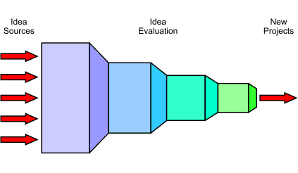
Evaluate the value of an idea
10 rules for idea evaluation (1)
Start with clearly presented, concrete innovation goals
Divide the process into phases
Idea Evaluation consists of three tasks: Refinement, Evaluation and Selection
Formulate refinement questions and evaluation criteria that serve the innovation goal
Selection must always be preceded by Evaluation and Evaluation must always be preceded by Refinement

Slide 13
Evaluate the value of an idea
10 rules for idea evaluation (2)
Never process an idea expensively that could have been eliminated cheaply
The amount of time spent on an idea should be inversely proportional to the number of ideas under consideration
Never compare apples and oranges
Never let anyone single-handedly kill or promote an idea who has a vested interest in it
Know the psychology of idea evaluation

Slide 14
Evaluate the value of an idea
How well is the idea formulated? How convincing does it sound?
Can the idea be implemented? Is the effort in relation to the benefit?
Are the necessary resources available for implementation? Does the company find the right people to take over the project management?
Is it worth it?
(1)

Slide 15
Evaluate the value of an idea
Benefits > Costs
Is it worth it?
(2)

Slide 16
Evaluate the value of an idea
Direct benefits (increased revenue..)
Indirect benefits (increased customer interest in product or brand..)
Intangible benefits (improved employee morale..)
Competitive benefits (being a first mover in an industry..)
Benefits

Slide 17
Evaluate the value of an idea
Direct costs (labor costs..)
Indirect costs (Fixed = utilities, rent..)
Intangible costs (decrease in productivity level, lower customer satisfaction..)
Opportunity costs (pursuing one product / strategy over another)
Costs

Slide 18
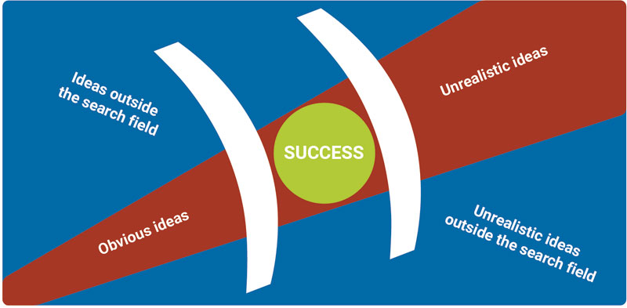
Evaluate the value of an idea
Identifying successful ideas

Slide 19
Evaluate the value of an idea
Let’s evaluate the idea of opening a store that sells fishing equipment. The store is situated in an urban area in the very center of the city.
How could you evaluate this idea?
What questions would you ask to find out if this idea can be successful?
Fishing equipment
Exercise 2

Slide 20
Evaluate the value of an idea
Time
Cost
Potential Impact
Monetary Impact
How much of the Organization is affected?
Business critical
Ownership
Linked to strategic goals
What to consider when evaluating ideas I ?

Slide 21
Evaluate the value of an idea
How much time will each idea take to plan, implement and produce results? Does the time investment reflect the idea’s value?
1. Time

Slide 22
Evaluate the value of an idea
What will it cost to bring this idea to life, including multiple pilots (if necessary) and a full rollout? Sometimes big changes are worth big investments, but you’ll need to be sure that you’ll get a return on your spend.
2. Costs

Slide 23
Evaluate the value of an idea
Is this a major shift in the way that you work? Will it change the way your clients see you? Big, bold ideas can be scary, but often highlight the changes that need to happen.
3. Potential impact

Slide 24
Evaluate the value of an idea
Is this idea going to directly impact your bottom line? Innovation should have a direct impact on your company finances, so always consider this dimension carefully.
4. Monetary impact

Slide 25
Evaluate the value of an idea
It’s important to pay attention to the needs of each team when evaluating your ideas. However, when you’re allocating resources, it often makes sense to prioritise the ideas that will affect the greatest number of people.
5. How much of the organization is affected?

Slide 26
Evaluate the value of an idea
How vital is it that this idea happens, and happens soon, for the survival of your business? Take a look at the wider landscape and think about how this idea sets you apart.
6. Business critical

Slide 27
Evaluate the value of an idea
Will someone be able to take ownership of this idea, and manage the process from start to finish? All innovation needs to be managed, so make sure your great idea is manageable.
7. Ownership

Slide 28
Evaluate the value of an idea
Your company already has a strategic direction, but does this idea fit? The best idea in the world is no use to you if it takes you in a direction you’re not trying to go in.
8. Linked to strategic goals

Slide 29
Evaluate the value of an idea
TIME
COST
POTENTIAL IMPACT
MONETARY IMPACT
HOW MUCH OF THE ORGANISATION IS AFFECTED?
BUSINESS CRITICAL
OWNERSHIP
LINKED TO STRATEGIC GOALS
SUMMARY

Slide 30
Evaluate the value of an idea
Tesco‘s 3 criteria
Tesco, a British retailer, uses the following criteria for selecting ideas in brainstorms or suggestions sessions:
Is it better? (For customers)
Is it simpler? (For staff)
Is it cheaper? (For Tesco)
Any idea that is better, easier and cheaper is likely to be a good idea and will probably be approved.
Notes:
https://www.destination-innovation.com/how-to-evaluate-ideas/

Slide 31
Evaluate the value of an idea
Tesco‘s 3 criteria
A couple years ago, McDonald’s introduced self-ordering machines in their restaurants in Austria.
According to Tesco’s 3 critera:
Is it better? (For customers) YES – it is faster
Is it simpler? (For staff) YES – the machine does the work
Is it cheaper? (For McDonald’s) YES – no one needs to take the orders
Question to everybody: Do you know other examples of companies that fulfilled those 3 criteria through an idea that got implemented?
Notes:
https://www.destination-innovation.com/how-to-evaluate-ideas/

Slide 32
Evaluate the value of an idea
Idea evaluation takes time and thought
Don’t waste your time on useless decisions
e.g.: should I eat Pizza or Salad for lunch?
Yes, the nutrients differ but:
Whatever you decide doesn’t really matter.
When NOT to evaluate ideas

Slide 33
Input on exercise
Conduct exercise on your own
Group discussion of findings/results
Evaluate the value of an idea
Evaluate your business idea
Group exercise:
EXERCISE 3: Evaluate your business idea (~90 min.)
Built groups of 5
Think about 4 innovative realistic business ideas
Rank ideas individually
Final ranking of ideas as a group
Write them on a flipchart and present ideas in front of all groups
Audience decides which idea they think won
Notes:
https://www.rockypeaklc.com/ideaevaluation.pdf page 23

Slide 34
Thank You!
Do you have any questions before we go?
The European Commission's support for the production of this publication does not constitute an endorsement of the contents, which reflect the views only of the authors, and the Commission cannot be held responsible for any use which may be made of the information contained therein.

