Slide 1
Introduction to the Workshop:
Managing complex tools to understand a concept idea and its value
Inspire Students Entrepreneurial Thinking to Drive Discovery, Creativity and Innovation
The European Commission's support for the production of this publication does not constitute an endorsement of the contents, which reflect the views only of the authors, and the Commission cannot be held responsible for any use which may be made of the information contained therein.

Slide 2
Managing complex tools to understand a concept idea and its value
After completion of the workshop, the learner should be able to:
Identify theories and principles connected to concept ideation
Determine ideation concepts for value creation
Evaluate winning and valuable concept ideas
Learning Outcomes to be Covered

Slide 3
Managing complex tools to understand a concept idea and its value
The workshop will offer an insight into the concept of design thinking with a stronger focus on the ideation process. In addition, once having developed an idea it is important to frame the idea and discuss the potential for further business operations.
Short Introduction

Slide 4
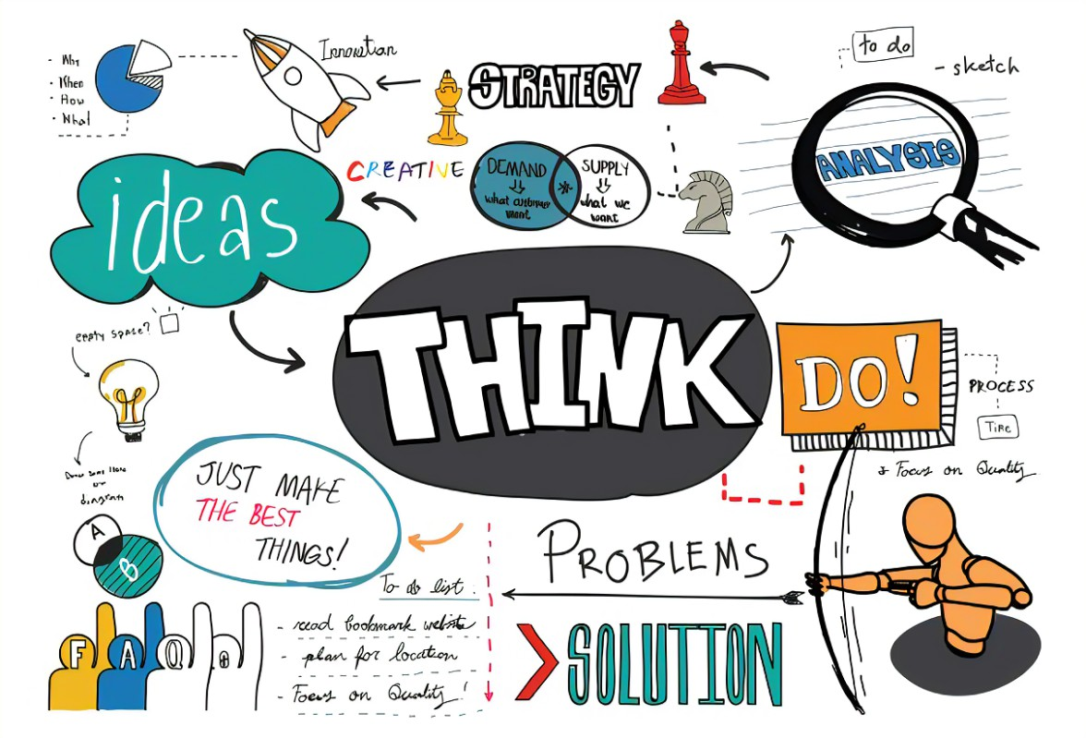
Managing complex tools to understand a concept idea and its value
Have you already been in touch with the concept of design thinking?
Notes:
Attachment 0.3

Slide 5
Managing complex tools to understand a concept idea and its value
Design thinking is an innovative problem-solving process rooted in a set of skills.
In addition, the design thinking process has been applied to developing new products and services, and to a whole range of problems, from creating a business model for selling solar panels in Africa to the operation of Airbnb.
What is design thinking?

Slide 6
Managing complex tools to understand a concept idea and its value
Why would a team or an organization apply design thinking?
There are a couple of reasons why the application of design thinking makes sense for teams and organizations:
Better understand the unmet needs of the people you’re creating for (customers, clients, students, users, etc...).
Reduce the risk associated with launching new ideas, products, and services.
Generate solutions that are revolutionary, not just incremental.
Learn and iterate faster.
Notes:
Attachment 0.3

Slide 7
Managing complex tools to understand a concept idea and its value
How to create a fitting solution for the involved stakeholders, clients and employees?
The solution ideally needs to fit customers´ needs, integrates customers´ conditions and circumstances and it is important to not create more of the same but invest in innovation.
Innovation is the central element in design thinking.
Core question in design thinking?

Slide 8
Managing complex tools to understand a concept idea and its value
The design thinking process

Slide 9
Managing complex tools to understand a concept idea and its value
Empathy – starting point of design thinking
Aim: to gain the greatest possible understanding of their environment, their situation and their needs
Iterative cycles (“constructive failing”) – “fail fast and move forward quickly”
Radical cooperation – interdisciplinary composition of teams to increase the innovation creation approach
Interdisciplinary participants – T-profiles of participants to be considered – different backgrounds
Inventive design – developing successful business models from good ideas with right processes, design-thinking rules, open attitude and interdisciplinary teams
Principles of design thinking

Slide 10
Managing complex tools to understand a concept idea and its value
Build on the ideas of others
Visualize your ideas
Encourage wild ideas
Only one speaks
Always think of the benefits
Develop as many ideas as possible
Hold back on criticism
Fail early, move fast
Focus and concentrate on the topic
9 rules of design thinking

Slide 11
Managing complex tools to understand a concept idea and its value
Individual steps within the design thinking process – Step 1: empathize
The Design Thinking process starts with empathy. To create desirable products and services, one needs to understand who the users and their needs.
What are their expectations to the product/service planned to be designed?
What challenges and pain-points do they face within this context?
During the empathize phase, one needs to spend time observing and engaging with real users — conducting interviews, seeing how they interact with an existing product, and generally paying attention to facial expressions and body language.
The empathize phase encourages one to set assumptions aside. Armed with first-hand insights, one will be able to design with real users in mind.
That’s what Design Thinking is all about!
Notes:
Attachment 0.3

Slide 12
Managing complex tools to understand a concept idea and its value
Individual steps within the design thinking process – Step 2: define
Definition of the user problem to be solved.
Gathering all findings from the previous phase and piece them together:
What common themes and patterns did you observe?
What user needs and challenges consistently came up?
Formulation of a problem statement essential to outline the issue or challenges on wants to address. The problem statement keeps the user in focus.
By the end of the define phase, one will have a clear problem statement which guides throughout the design process. This will form the basis for generating potential ideas and potential solutions.
Notes:
Attachment 0.3

Slide 13
Managing complex tools to understand a concept idea and its value
Ideation is the process of forming ideas and concepts.
In the corporate environment, “Ideation” defines the generation of new ideas and concepts to solve specific problems, either problems that customers or clients are facing (thus creating business concepts for new products and services that your organization can provide them with), or problems that an organization is experiencing (thus resulting into improvements in the internal structure or processes).
Individual steps within the design thinking process – Step 3: ideate

Slide 14
Managing complex tools to understand a concept idea and its value
Individual steps within the design thinking process – Step 3: ideate
This step consists of ideation = generation of ideas = generation of innovation
Target users and their needs in terms of products/services are already known and one aims to produce a solution for a problem statement.
Now it is time to come up with possible solutions.
The ideation phase is a judgement-free zone where the group is encouraged to venture away from the norm, to explore new angles, and to think outside the box. Ideation sessions are held to generate as many ideas as possible – regardless of whether or not they are feasible. or maximum creativity, ideation sessions are often held in unusual locations.
Referring back to the problem statement is essential to focus. As you prepare to move on to the next phase, you’ll narrow it down to a few ideas which you’ll later turn into prototypes to be tested on real users.
Notes:
Attachment 0.3

Slide 15
Managing complex tools to understand a concept idea and its value
Individual steps within the design thinking process – Step 3: ideate
Ideation techniques to be supportive
Brainstorming – an all time classic – check out the webtool www.demo.flinga.fi
Worst ideas – come up with the worst ideas – to also include those who feel insecure
Storyboarding – helpful to designing and improving processes – creation of visual stories
Mind mapping – relationships between the problem – padlet.com or miro.com
SCAMPER – 7 ways to look at a problem – subsitute/combine/adapt/modify/put to another use/eliminate/reverse – products and services
Notes:
Attachment 0.3

Slide 16
Managing complex tools to understand a concept idea and its value
Exercise on elaborating a business idea – Step 3: ideate
This exercise can be done individually by those students who really want to work on their own business idea but also groups of max. 5 people can be formed.
Based on what you have learnt on the design thinking process and the ideation step, please come up with at least one (1) business idea to be implemented into practice following previously discussed methods.
Time for the task: 45 minutes for the development
Short presentation of each idea to the group (max. 3 minutes per group – pitch) incl. discussion with other students & trainer.
Afterwards – fine-tuning of developed ideas
Notes:
Attachment 0.3

Slide 17
Managing complex tools to understand a concept idea and its value
Individual steps within the design thinking process – Step 4: prototype
Take the ideas defined in step 3 into prototypes.
Gathering all findings from the previous phase and piece them together:
What common themes and patterns did you observe?
What user needs and challenges consistently came up?
A prototype is essentially a scaled-down version of a product or feature - be it a simple paper model or a more interactive digital representation.
The aim of the prototyping stage is to turn an ideas into something tangible which can be tested on real users. This is crucial in maintaining a user-centric approach, allowing to gather feedback before one goes ahead and develops the whole product. This ensures that the final design actually solves the user’s problem!
Notes:
Attachment 0.3

Slide 18
Managing complex tools to understand a concept idea and its value
Individual steps within the design thinking process – Step 5: test
Putting the developed prototypes in front of real users and seeing how they get on.
During the testing phase, one observes the target users—or representative users—as they interact with a prototype. One also gathers feedback on how users felt throughout the process.
The testing phase will quickly highlight any design flaws that need to be addressed. Based on what has been learnt through user testing, one goes back and makes improvements.
Remember: The Design Thinking process is iterative and non-linear.
Notes:
Attachment 0.3

Slide 19
Managing complex tools to understand a concept idea and its value
Putting ideas into a framework is essential to start working with them in more detail – see step 4 & 5
Once an ideas has been tested and approved by the major customers, it is time to start working on the conceptualization of a selected idea = part of the business strategy development.
Focusing once more on ideas

Slide 20
Managing complex tools to understand a concept idea and its value
Great ideas are big businesses.
Just because one has created a presumable good idea it does NOT mean that it is also a good business idea.
A profound evaluation of the idea generated is important. It decides on whether an entrepreneur make it or break it.
It is important to do some research before starting with investments (financial and timewise).
Idea ≠ business idea

Slide 21
Managing complex tools to understand a concept idea and its value
Determine a target market
Create a buyer persona
Conduct a market analysis
Analyze competitors
Understand finances
5 steps to evaluate the potential of a business idea

Slide 22
Managing complex tools to understand a concept idea and its value
1. Determine the target market
A target market is the group of people an entrepreneur plans on selling products or services to.
A target market comprises consumers that an entrepreneur believes would benefit most from the business idea and will become sustained customers of the business.
It's important to learn from this group about their needs to adapt the business idea and later market to them successfully.
When an entrepreneur understands its consumers well, it is easier to adapt to their needs also during the business operations which in the end determines success.
Notes:
Attachment 0.3

Slide 23
Managing complex tools to understand a concept idea and its value
2. Create a buyer persona
A persona is a fictional representation or character of your ideal customer or user. A persona is created based on research gathered from user interviews.
Using personas can help to better understand the needs, behaviors and expectations of a potential target audience. They also help create solutions at a quicker pace that can result in overall user experience benefit. The use of personas helps to strategize and make wise decisions for the benefit of not only a product but the users as well.
What makes up a persona´s profile?
Fake name, personal background, professional background, environment, psychological traits, image, quote
Notes:
Attachment 0.3

Slide 24
Managing complex tools to understand a concept idea and its value
3. Conduct a market analysis & 4. Analyze your competitors
A market analysis is an assessment of market conditions, which may include economic details, consumer buying patterns, trends, forecasting and the competition in a market.
Conducting a market analysis will support in identifying business opportunities and threats. It is important to conduct the market analysis in two steps – macro- and micro-level analysis.
Simply put, a market analysis helps to understand potential of the aimed market and needs to be revised on a regular basis.
An essential part within the market analysis is the analysis of the competitors. If competitors are big on the market, then one needs to question if there is potential out there to enter the market
Notes:
Attachment 0.3

Slide 25
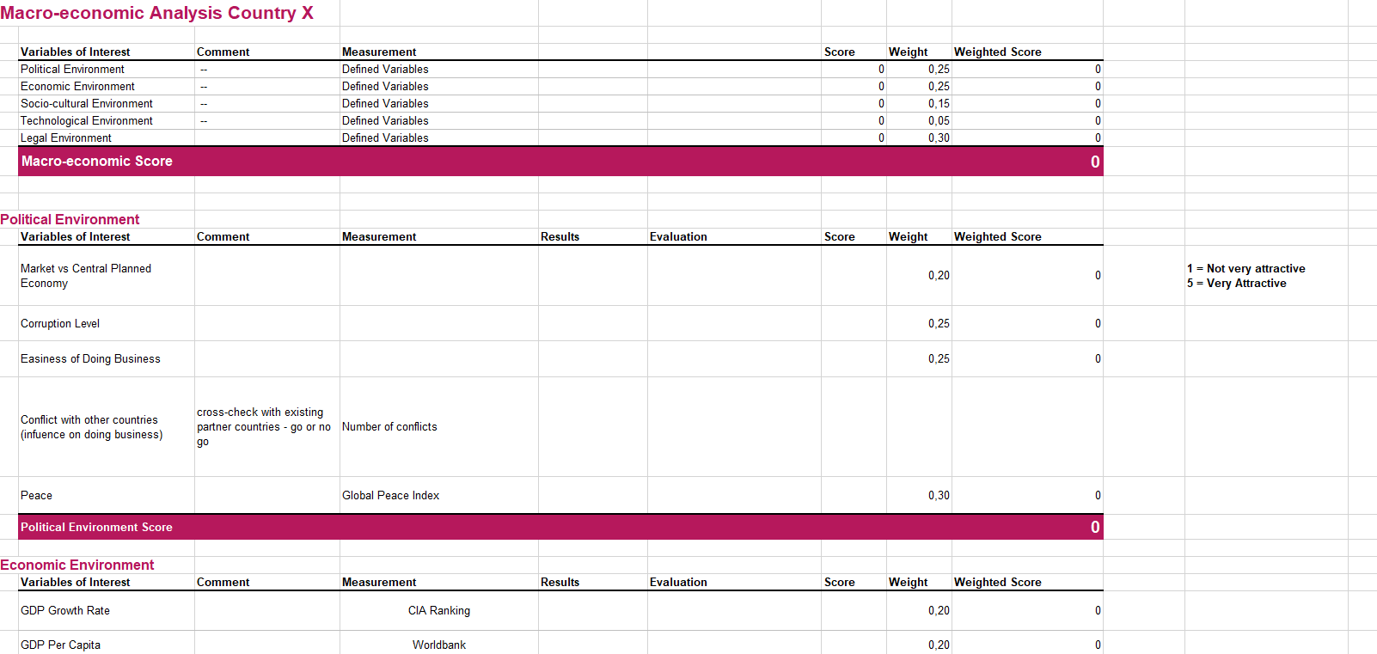
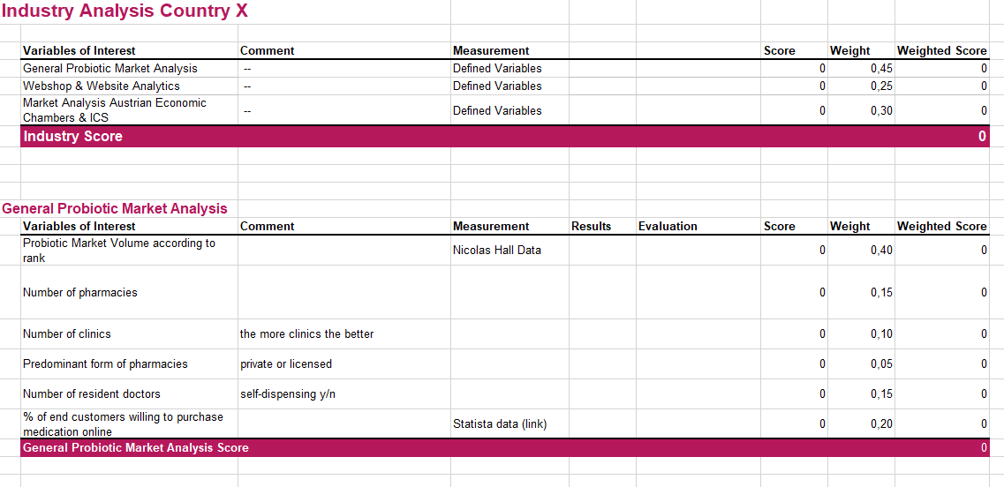
Managing complex tools to understand a concept idea and its value
3. Conduct a market analysis & 4. Analyze your competitors – some options
Notes:
Attachment 0.3

Slide 26
Managing complex tools to understand a concept idea and its value
3. Conduct a market analysis & 4. Analyze your competitors
Major sources for collecting market data are:
World bank - World Bank Open Data | Data
UN data - social and economic data – Undata
International monetary fund – World Economic Outlook - World Economic Outlook Databases (imf.org)
Eurostat - Home - Eurostat (europa.eu)
OECD iLibrary - OECD iLibrary (oecd-ilibrary.org)
Embassy and foreign trade centers are often also willing to support
Also check on organisations and associations that are directly connected to your topic
Notes:
Attachment 0.3

Slide 27
Managing complex tools to understand a concept idea and its value
Exercise on market analysis
This exercise should either be done individually as in the previous task or in the same groups as before.
Task: Students should check on template once more and then shall try to analyse their target market with the provided template and hints. It is essential that the students start working with the template and get used to a methodological approach.
The trainer will guide all students/student groups through the development process to create a draft version and have a first feeling on whether a go or no-go decision will be the consequence of their analysis,
Notes:
Attachment 0.3

Slide 28
Managing complex tools to understand a concept idea and its value
5. Understand your finances
Part of evaluating a business idea is being able to understand the finances associated with the launch of the idea.
You'll want to ask yourself:
How will I get the funds I need to start my business?
How much money do I need to begin?
What is my projected income and expenses?
What's my total earning potential in the first month? Three months? One year?
How will I realize sustained profits?
Notes:
Attachment 0.3

Slide 29
Thank You!
Do you have any questions before we go?
The European Commission's support for the production of this publication does not constitute an endorsement of the contents, which reflect the views only of the authors, and the Commission cannot be held responsible for any use which may be made of the information contained therein.

