Slide 1
Introduction to the Workshop:
The learner is expected to communicate, negotiate, and lead in situations
Inspire Students Entrepreneurial Thinking to Drive Discovery, Creativity and Innovation
The European Commission's support for the production of this publication does not constitute an endorsement of the contents, which reflect the views only of the authors, and the Commission cannot be held responsible for any use which may be made of the information contained therein.

Slide 2
The learner is expected to communicate, negotiate, and lead in situations
The learner is expected to communicate, negotiate, and lead in situations
The learner should be able to:
• explain the importance of soft skills in interacting
• describe the essentials of negotiation
• explain the key principles to communicate and lead in different situations
• identify appropriate tools for leadership practice
• apply tools to rely on through leadership practice
Learning Outcomes to be Covered

Slide 3
The learner is expected to communicate, negotiate, and lead in situations
This Workshop includes 3 activities.
The first activity explains the difference between Soft and Hard Skills. It analyzes a set of non-specialized cross-professional skills responsible for building a career, interaction with a team, and relationships with others.
The second activity practices the strategies and skills to help trainees become successful negotiators in their personal life and business transactions.
The third activity identifies leaders' skills and explains when specific leadership styles are appropriately used. Finally, there is a short online quiz that allows the self-assessment of the trainees.
Short Introduction

Slide 4
The learner is expected to communicate, negotiate, and lead in situations
Activity 1: Soft skills
Soft skills are a mix of interpersonal skills, common sense, personality, emotional intelligence and attitude towards people and are very important for success in the workplace as they impact how we perform and interact with our co-workers.
Soft skills are different from hard skills (also known as technical skills), which are directly relevant to the job for which you are applying. Hard skills are often more quantifiable, and easier to learn than soft skills.

Slide 5
The learner is expected to communicate, negotiate, and lead in situations
Leadership
Communication
Teamwork
Time management
Problem solving
Critical thinking
Creativity
Adaptability
Soft Skills

Slide 6
The learner is expected to have the motivational capacity to activate others
Exercise 1
The topic of this game is “success”, so participants will share their ideas on what makes something or someone successful.
Think of a peak experience of whatever the topic is (e.g., the best work meeting you ever had; the best-organised conference you attended; the most engaging speaker you ever heard; the most interesting presentation you remember; the best piece of work you did etc.). Share your story with the rest of the group.
Use a worksheet (Attachment C10_6_02) to write down your the elements of success.

Slide 7
The learner is expected to communicate, negotiate, and lead in situations
Activity 2: Negotiation
A negotiation can contain compatible and/or incompatible interests between the negotiators.
Integrative negotiation means that interests are neither completely oppositional nor
completely compatible. This integrative potential allows a mutual agreement which is reached when both of the parties achieve a result higher than the simple 50-50 compromise.
Distributive negotiation is that the negotiator has to investigate the question how to divide a fixed amount of resources in a negotiation. Distributive negotiation is a zero-sum game from the perspective of game theory, where the value along a single dimension shifts in either direction - one side is better off and the other is worse off.
In daily life, there may be both compatible interests as well as incompatible interests for the negotiators in a single negotiation - in other words, negotiation contains a mixed-motive of distributive and integrative elements.
Great negotiators have the ability to look at a negotiation from the perspective of the other side.

Slide 8
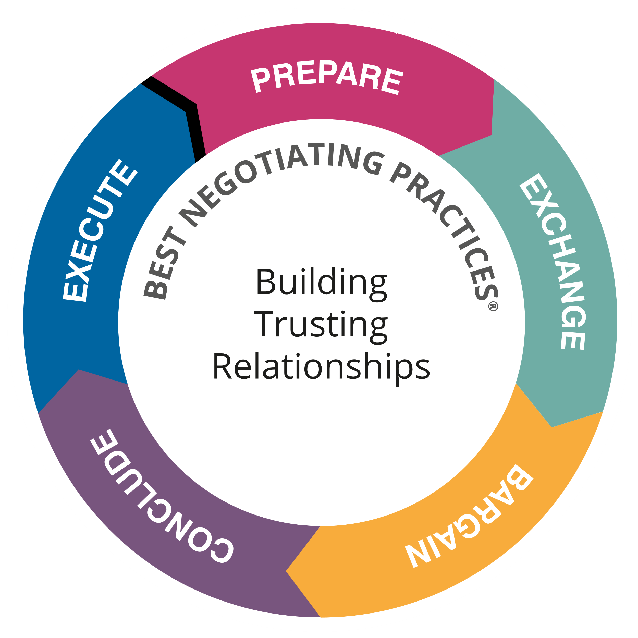
The learner is expected to communicate, negotiate, and lead in situations
Stages of negotiation process
Prepare
Identify potential value. Begin to understand interests. Develop fact-base
2. Information Exchange and Validation
Discovering and creating value. Assess interests. Build rapport and trust
3. Bargain
Create and distribute value. Address interests. Make and manage concessions
4. Conclude
Capture value. Confirm interests have been met. Thank them
5. Execute
Expand value. Addressing changing interests . Strengthen relationships

Slide 9
The learner is expected to communicate, negotiate, and lead in situations
Conduct a negotiation analysis
Basic questions when conducting a negotiation analysis:
What is my overall goal in the negotiation? Why is this your goal?
What issues are most important to me in reaching this goal and why are these issues important?
What is my Best Alternative to a Negotiated Agreement (BATNA)? What is your best alternative if there is no deal? Identifying your best alternative is especially important because this is what gives you leverage in a negotiation. With a strong alternative you are more powerful in the negotiation.
What is my reservation price? This is the highest price a buyer is willing to pay or the lowest price a seller is willing to take.
What is the most likely price?
What is my stretch goal? Your stretch goal in a negotiation like this is a number that is higher than the most likely price from the seller’s perspective and lower than the most likely price from the buyer’s perspective

Slide 10
The learner is expected to communicate, negotiate, and lead in situations
Conduct a negotiation analysis
In answering previous questions, it often helps to visualize your conclusions.
Reservation price
Most likely
Stretch
BATNA
price

Slide 11
The learner is expected to have the motivational capacity to activate others
Exercise 2
Let’s assume that you are engaged in a simple, everyday negotiation—the sale of a car. You are preparing to negotiate with a potential buyer, Mike. He is the only person who responded to your sales ad. You need at least €5,000 from the sale of the car to finance the purchase of a new car you ordered. You want to keep your car for three more weeks, which is when the car will arrive. The reasonable value of the car (based on several online calculators) is €6,000. If you can’t find a buyer willing to pay at least €5500, you will sell the car to your friend Terry for €5000. You know that Terry will let you keep the car for the next three weeks.
Use a worksheet (Attachment C10_6_03) to write down your answers.

Slide 12
The learner is expected to communicate, negotiate, and lead in situations
Activity 3: Leadership
Leadership can be defined as determining a path that a group will follow, leading a group to reach a goal and owning the required skill set to mobilize followers with intrinsic motivation.
3 facts about leadership:
Leadership emerges as a process from the experience of individuals working together.
Leadership is not fixed for a single individual or an appointed “leader.” It moves predictably within groups of people.
Leaders perform their duties invisibly and guide the conduct of activities without instructions and without specifying the source.

Slide 13
The learner is expected to communicate, negotiate, and lead in situations
Leadership theories
Trait theory. The theory of traits states that there are some characteristics that distinguish the leader from the followers.
2. Behavioural leadership theory. The behavioural leadership theory focuses on how leaders behave and assumes that these traits can be copied by other leaders. Action rather than qualities are the focal points of this theory.
3. Situational leadership theory. The situational leadership approach argues that leadership characteristics and behaviours should act together with situational varieties to assume results. According to this approach, the acquired characteristics are significant with leaders’ interests in their situational circumstances.

Slide 14
The learner is expected to communicate, negotiate, and lead in situations
Leadership behaviours (1)
Directive leader behaviour. It assures the followers know the expectations from them by planning and coordinating work, providing specific guidance and psychological structure and clarifying policies, procedures and rules. Directive leaders set out strict performance standards for their followers.
Supportive leader behaviour. It focuses on sub-needs and preferences such as showing concern for the well-being of the followers and creating a friendly and psychologically supportive work environment. Supportive leaders attach great importance to the needs and well-being of followers

Slide 15
The learner is expected to communicate, negotiate, and lead in situations
Leadership behaviours (2)
Participative leader behaviour. In this leadership behaviour, the leader asks for and uses the followers’ suggestions; however, the leader makes the decisions.
Achievement-oriented leader behaviour. Achievement-oriented behaviour refers to identifying challenging targets, seeking improvement, emphasizing excellence in performance and showing confidence in achieving high performance standards for the subordinates. Achievement oriented leader behaviour contributes to their subordinates’ efforts to achieve higher performance standards and to have greater confidence in
their ability to achieve challenging goals.

Slide 16
The learner is expected to have the motivational capacity to activate others
Exercise 3
Divide the learners into groups.
Each group discussing leaders they know and why they admire them.
After 30 minutes groups come back together for a larger discussion.

Slide 17
Thank You!
Do you have any questions before we go?
The European Commission's support for the production of this publication does not constitute an endorsement of the contents, which reflect the views only of the authors, and the Commission cannot be held responsible for any use which may be made of the information contained therein.

