Slide 1


Introduction to the Workshop:
The learner is expected to have the motivational capacity to activate others
Inspire Students Entrepreneurial Thinking to Drive Discovery, Creativity and Innovation
The European Commission's support for the production of this publication does not constitute an endorsement of the contents, which reflect the views only of the authors, and the Commission cannot be held responsible for any use which may be made of the information contained therein.

Slide 2
The learner is expected to have the motivational capacity to activate others
The learner is expected to have the motivational capacity to activate others.
The learner should be able to:
• recognize the role of motivation which drives a person to work in a certain way to achieve desired goals
• explain the fundamental rules of interaction and social behaviour
• describe different motivation techniques
• apply motivation theories
• analyze performance problems
Learning Outcomes to be Covered

Slide 3
The learner is expected to have the motivational capacity to activate others
  This Workshop includes 3 activities.
  The first activity introduces the essence of motivation and the main motivational theories to the VAT students.
  The second activity presents some motivation techniques. And the third activity focuses on approaches to analyzing performance problems. Finally, there is a short online quiz that allows the self-assessment of the trainees.
Short Introduction

Slide 4
The learner is expected to have the motivational capacity to activate others
Activity 1: Motivation and theories of motivation
  Motivation is why a person acts or behaves in a particular way. It drives our willingness and desire to do something.
  In the world of management, motivation has a more specific meaning. It's all about the factors that encourage individuals to be continually committed and interested in their jobs.
  Different individuals are motivated by different things.

Slide 5
The learner is expected to have the motivational capacity to activate others
Intrinsic vs. Extrinsic motivation
  Intrinsic motivation comes from within: the enjoyment of a task, the satisfaction of a job well done, and the desire to achieve are all sources of intrinsic motivation.
  Extrinsic motivation comes about because of external factors such as a bonus or another form of reward. Avoiding punishment or a bad outcome can also be a source of extrinsic motivation; fear, it is said, can be a great motivator.

Slide 6
The learner is expected to have the motivational capacity to activate others
Need theories of motivation
  Need theories of motivation use personal characteristics or attributes to explain motivation.
  In this group we include:
  Murray’s theory of human personality
  Maslow’s hierarchy of needs theory
  Herzberg’s motivator-hygiene theory

Slide 7
The learner is expected to have the motivational capacity to activate others
Murray’s theory of human personality
  This theory views people as adaptive when facing a dynamic and changing environment. Human behaviour is goal-directed and purposeful. Factors internal to the person (needs) and in the person's external environment govern behaviour.
  People learn from their interactions with their external environment and from previous experiences. They also hold preconceptions about what the future will be like.
  The theory puts needs into two classes – physical and psychological. Physical needs are concerned with the satisfaction of the basic physical processes of the human body, such as the needs for food, air, and water. Psychological needs focus on emotional and
  mental satisfaction

Slide 8
The learner is expected to have the motivational capacity to activate others
Some needs in Murray’s theory
Need | Desire To
Achievement | Attain difficult goals; perform as well as possible.
Acquisition | Gather property, belongings, and objects.
Affiliation | Associate with others, have friends, and join groups.
Autonomy | Be independent and not be influenced by others.
Deference | Respect authority; admire a person with authority.
Dominance | Command, control, and influence others; affect a group’s direction.
Exhibition | Draw attention to oneself.
Nurturance | Help others, give aid, improve the condition of other people.
Order | Organize and systematically arrange objects; be clean, neat, and tidy.
Recognition | Receive credit for actions; seek honors and recognition.

Slide 9
The learner is expected to have the motivational capacity to activate others
Maslow’s hierarchy of needs theory
  Maslow felt that needs could be put into five groups of basic human needs that all healthy adults try to satisfy. According Maslow those needs are so basic that they motivate the behaviour of people in many different cultures.
  Needs formed a need hierarchy.
  According to the theory, people must satisfy the needs at the bottom of the hierarchy before higher-level needs emerge as important or prepotent.
  An unsatisfied need is a potential motivator of behaviour.
  After a person satisfies a need at one level, the need at the next level in the hierarchy becomes the focus of behaviour.

Slide 10
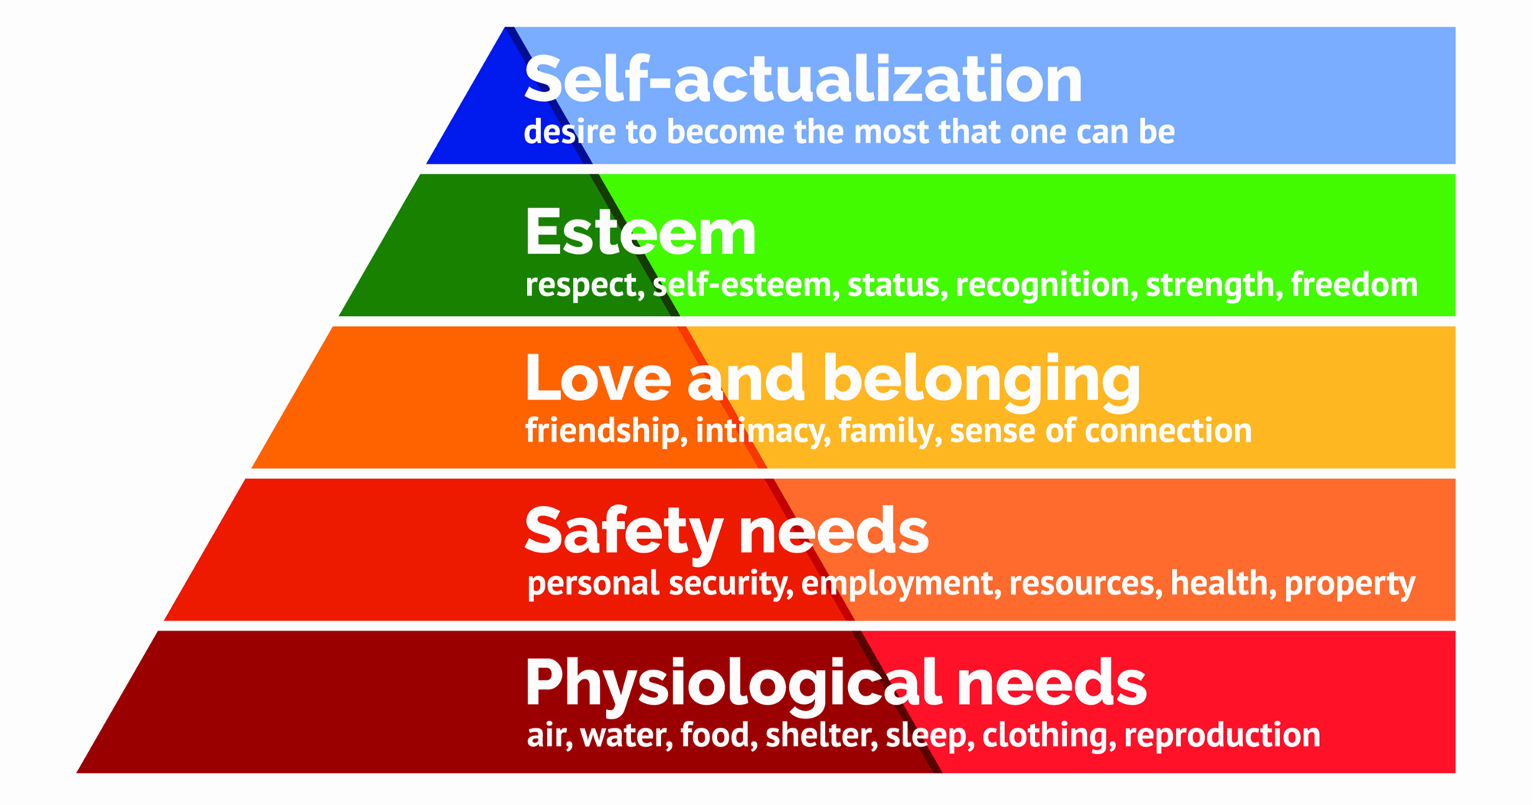
The learner is expected to have the motivational capacity to activate others
Maslow’s hierarchy of needs

Slide 11
The learner is expected to have the motivational capacity to activate others
Herzberg’s motivator-hygiene theory
  The Herzberg's motivation-hygiene theory argues that job satisfaction and dissatisfaction exist on two different continua, each with its own set of factors. This runs contrary to the traditional view of job satisfaction, which posits that job satisfaction and dissatisfaction are interdependent.
  Generally, these factors encouraging job satisfaction relate to self-growth and self-actualization.
  To Herzberg, motivators ensured job satisfaction while a lack of hygiene factors spawned job satisfaction.

Slide 12
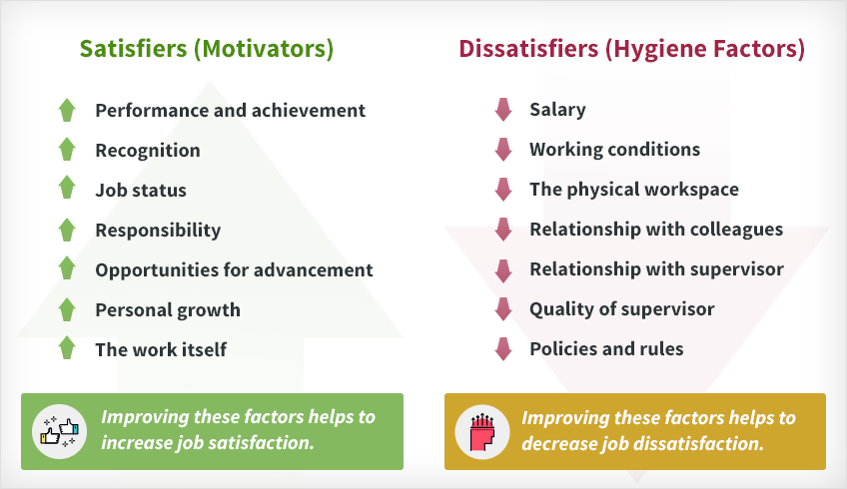
The learner is expected to have the motivational capacity to activate others
Herzberg’s motivator-hygiene theory

Slide 13
The learner is expected to have the motivational capacity to activate others
Cognitive theories of motivation
  Cognitive theories of motivation seek to explain our behaviours as a product of the careful study and active processing and interpretation of information received.
  In this group we include:
  expectancy theory
  equity theory
  goalsetting theory

Slide 14
The learner is expected to have the motivational capacity to activate others
Expectancy theory
  Expectancy theory makes certain assumptions about what people do when deciding how to behave. The following four assumptions underlie expectancy theory:
  Forces in the environment and the individual interact to affect behaviour.
  People choose among different courses of action.
  People make those choices based on preferences for the outcomes of those actions.
  The choices among alternatives are rational and based on a person’s perceptions of the value of the results of various actions. An individual moves toward outcomes valued positively and avoids outcomes valued negatively.

Slide 15
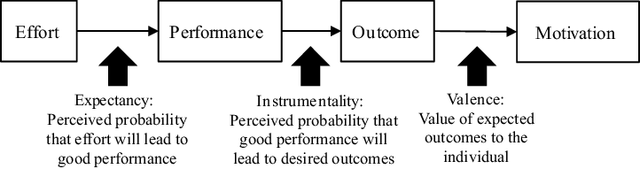
The learner is expected to have the motivational capacity to activate others
Expectancy theory

Slide 16
The learner is expected to have the motivational capacity to activate others
Equity theory
  Equity theory tries to explain the behavioural dynamics of human exchange relationships. Any social relationship in which one person gives something to get something in return is an exchange relationship. Because one party is giving to the exchange, and another party is receiving, either party can perceive the exchange as inequitable or unfair.
  Equity theory says people try to balance their ratios of inputs to outcomes from an exchange relationship.
  Equity theory showed us that a manager must be careful when using extrinsic outcomes for job performance. If a person feels inequitably treated in comparison to someone else, the individual might decrease performance or leave the organization.

Slide 17
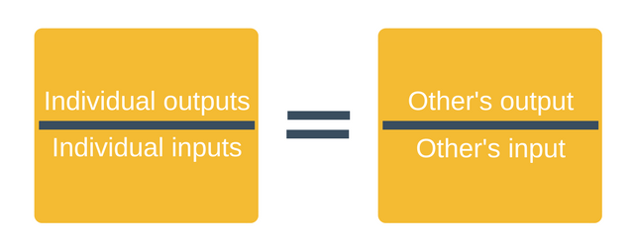
The learner is expected to have the motivational capacity to activate others
Equity theory

Slide 18
The learner is expected to have the motivational capacity to activate others
Goalsetting theory
  The theory states that goal setting is essentially linked to task performance.
  Goals indicate and give direction to an employee about what needs to be done and how much efforts are required to be put in.
  Goals that are specific, challenging, reachable, and accepted by a person lead
  to higher performance than goals that are fuzzy, unchallenging, not reachable,
  or not accepted.
  Goal specificity includes what needs to be done, how much needs to be done, and the performance period. High performance is partly the result of clear expectations about what to do and when.

Slide 19
The learner is expected to have the motivational capacity to activate others
Behavioural theory of motivation
  The theory assumes that people engage in behaviour that has positive outcomes and avoid behaviour that fails to produce positive outcomes.
  Managers try to shape behaviour by applying or withdrawing consequences of the behaviour. Those consequences are either positive or negative for the target person. Managers use four approaches to affect the nature and direction of behaviour: positive reinforcement, punishment, extinction, and negative reinforcement.

Slide 20
The learner is expected to have the motivational capacity to activate others
Applying and Withdrawing Positive and Negative Events
Positive events
Negative events
Positive reinforcement
Applies a positive event to
Increase frequency of desirable behaviour
Extinction
Withdraws a positive event to
Decrease frequency of undesirable behaviour
Punishment
Applies a negative event to
Decrease frequency of undesirable behaviour
Negative reinforcement
Withdraws a negative event to
Increase frequency of desirable behaviour

Slide 21
The learner is expected to have the motivational capacity to activate others
Exercise 1
  Use a worksheet (Attachment C10_5_02) to write down your answers to the following questions:
  What the similarities and differences are between Maslow’s hierarchy of needs theory and Herzberg’s motivator-hygiene theory?
  What the similarities and differences are between goal-setting theory and behavioural theory?
  What insights do you gain from each theory?

Slide 22
The learner is expected to have the motivational capacity to activate others
Activity 2: Motivational techniques
Techniques | Explanation
Financial incentives | Wages, salary motivates employees to perform better. It fulfils psychological safety and status need as people satisfy their needs by money
Job enlargement | The task assigned to do job are increased by adding simile task. So the scope of job enlargement is high for the motivation of subordinates.
Job enrichment | Jobs are made challenging and meaningful by increasing responsibility and growth opportunities.
Job rotation | It refers to shifting an employee from one job to another. By this it helps to develop the competency in several jobs which helps in development of employees.
Participation | Participation refers to involvement of employee in planning and decision-making . It helps the employees feel that they are an asset of the organization which helps in developing ideas to solve the problems.
Delegation of authority | It is concerned with the granting of authority to the subordinates which helps in developing a feeling of dedication to work in an organization because it provides the employees high morale to perform any task.
Quality of work life | It is the relationship between employees’ and the total working environment of organization. It integrates employee needs and well-being with improves productivity, higher job satisfaction and great employee involvement. It ensures higher level of satisfaction.
Management by Objectives | By this technique supervisor and subordinates set individual and organizational goals. Each individual’s responsibilities are clearly defined which would help identify the skill sets one has to make the best use of the same to meet organizational mission and vision.
Behaviour modification | It develops positive motivation to the workers to do the work in desired behaviour in order to modify behaviour.

Slide 23
The learner is expected to have the motivational capacity to activate others
Activity 3: Identifying motivation problems
  Poor job performance may be caused by a number of factors, including:
  the employee does not understand the expectations for performance
  the employee does not have the skills to meet the expectations
  the employee does not have the time or resources to do the job properly
  the employee is capable of meeting the expectations but is not motivated to do so
  the expectations for performance are so high that nobody could meet them

Slide 24
The learner is expected to have the motivational capacity to activate others
Performance Analysis Quadrant
  When the performance of an individual or team is being questioned, often the first solution tried is training.
  But is this right?
  One tool which can help us identify the appropriate solution is known as the Performance Analysis Quadrant. It is based on the answers to two basic questions:
  Does the employee have adequate job knowledge?
  Does the employee have the appropriate attitude to perform the job?
  For each of these questions give a score of 1-10. where 1 is low. 10 is high.

Slide 25
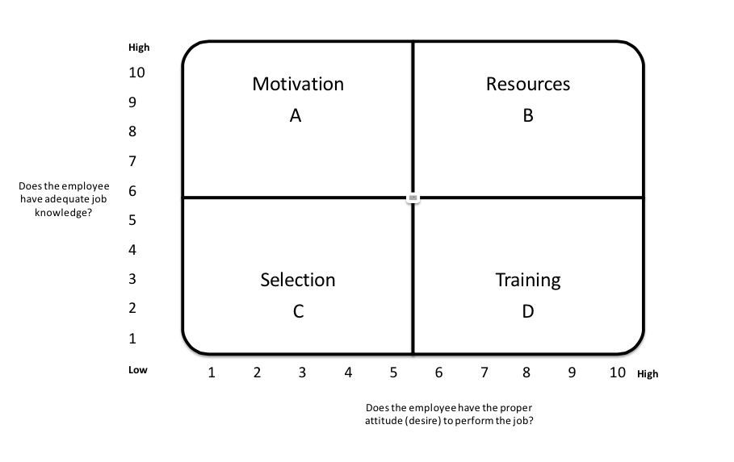
The learner is expected to have the motivational capacity to activate others
Performance Analysis Quadrant

Slide 26
The learner is expected to have the motivational capacity to activate others
Performance Analysis Quadrant
  Quadrant A: If the employee has sufficient job knowledge but has an improper attitude, this may be classed as motivational problem. The consequences (rewards) of the person's behaviour will have to be adjusted.
  Quadrant B: If the employee has both job knowledge and a favourable attitude, but performance is unsatisfactory, then the problem may be out of control of the employee. i.e. lacking resources, bad process, time pressures. An environmental analysis is called for.
  Quadrant C: If the employee lacks both job knowledge and a favourable attitude, that person may be improperly placed in the position. This may imply a problem with employee selection and suggest that transfer or discharge should be considered.
  Quadrant D: If the employee desires to perform, but lacks the requisite job knowledge or skills, then additional training may be the answer.

Slide 27
The learner is expected to have the motivational capacity to activate others
Exercise 2
  Direct the learners to draw a mental image of an employee they know who is not performing adequately. With their knowledge of the facts available, ask them to select an intersection point in the Performance Analysis Quadrant that best portrays their answers to the two questions on the vertical and horizontal axes dealing with knowledge and attitude.
  Use a worksheet (Attachment C10_5_03) to write down your answers.

Slide 28
Thank You!
Do you have any questions before we go?
The European Commission's support for the production of this publication does not constitute an endorsement of the contents, which reflect the views only of the authors, and the Commission cannot be held responsible for any use which may be made of the information contained therein.

